Slide 1
Healthy Living Partner
The HEART framework
Pitch a product vision
Product Owner: Francis Odo
© 2019 Udacity. All rights reserved.

Slide 2
Background
Why Are We Here?
Rising cost of healthcare is a major problem to patients and healthcare providers. KP wants to explore solutions through technological innovations that promotes healthy habits, which in return reduce or eliminate chronic disease.
A mobile application that tracks and monitors healthy habits.
[“Healthy Living”]
© 2019 Udacity. All rights reserved.

Slide 3
Business Case
© 2019 Udacity. All rights reserved.
Notes:
[ALL PARTICIPATION]

Slide 4
Initial Focus
Where are we starting?
Diabetes is a major common disease that is financially costly to the society.
Health problems : damage to the large blood vessels of the heart, brain and legs (macrovascular complications) and to small blood vessels, causing problems in the eyes, kidneys, feet and nerves
Healthcare problems : Extremely costly to diagnose. About $245B “wasteful cost” in diagnosis that could be avoided/saved
Solution focus is to prevent this disease through life changing healthy habits by tracking and monitoring, thereby reducing healthcare costs and saving lives.
© 2019 Udacity. All rights reserved.

Slide 5
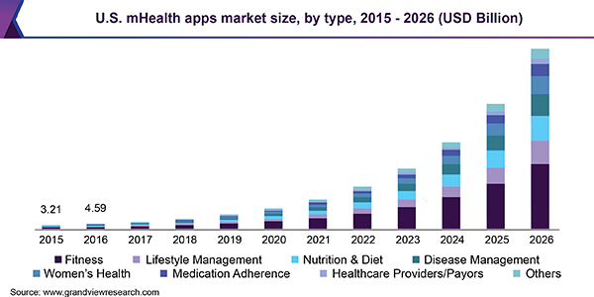
Opportunity
Mobile Health Apps Market

Slide 6
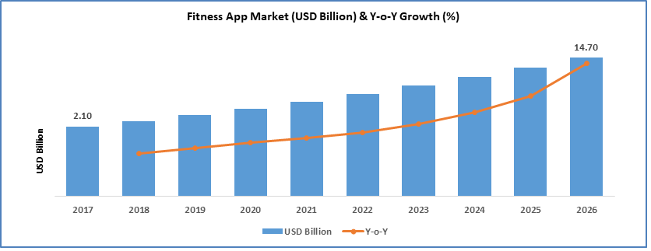
Fitness App Market Growth Projection

Slide 7
Opportunity
What’s the problem?
[ Mobile Health apps market size was valued USD 12.4 billion in 2018, projected to expand at a CAGR of 44.7% over the forecast period.
Estimated cost of diagnosed diabetes in 2017 is $327 B, including $237 B in direct medical costs. (https://care.diabetesjournals.org/content/early/2018/03/20/dci18-0007]
About 33 percent of American adults could have diabetes by 2050.
2018 Global healthcare sector’s revenue was $1.853 trillion, with an increase of 4.5% on a yearly basis.
Healthcare yearly expenditures, US spends $10,224 per person.
Americans will spend $3.65 trillion on health, which amounts to 17.8% of the country’s GDP]. https://policyadvice.net/insurance/insights/healthcare-statistics
Target Audience - Adults aged 45 to 74, plus new cases within 18 to 44
Total Addressable Market(TAM) for this opportunity - About $400 million
© 2019 Udacity. All rights reserved.

Slide 8
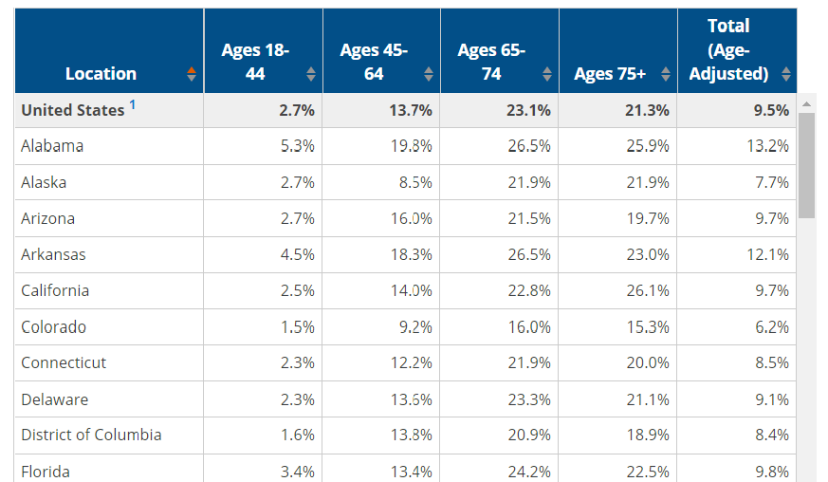
Target Audience Age Category

Slide 9
Proposal
What’s Our Solution?
A mobile application that recommends, monitors and tracks healthy habits
-Healthy diet menu(Breakfast, Lunch, Dinner)
-Calendar and Time Schedule
-Recommend daily exercise activities
-Track steps and strides daily
-Blood sugar or Glucose level monitor
-Alarm
-API for integration
© 2019 Udacity. All rights reserved.

Slide 10
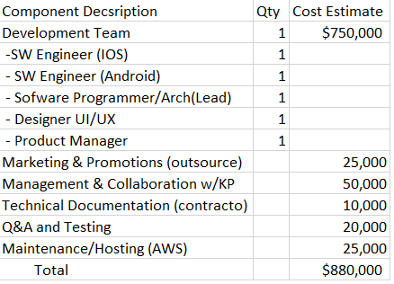
Cost of Development

Slide 11
Return On Investment(ROI)
Total Estimated Cost- 880K
Subscription (monthly) - $3.99
Subscription (yearly) - $40.00
Target membership volume (12 months) - 50,000 Members
Return On Investment (ROI) - 130%

Slide 12
Measurement
How will we know if we’re successful?
[Minimum Viable Product ready by the end of the first 6 months.
Business - 2000 Trial members, 1000 subscribers
Product - Member/Subscriber usage (through account activity - active user
Frequency of use or session length )
Quality - Efficiency(Ease of use), Ratings, Success stories, Feedback, App Store ratings
Development] - Pilot/Early release in 3 months ,Beta test completion in 6 months
© 2019 Udacity. All rights reserved.

Slide 13
Competitors
© 2019 Udacity. All rights reserved.
Notes:
[ALL PARTICIPATION]

Slide 14
Momentum - by Apple/Mathias Maehlum
E.G. []
[Momentum Habit Tracker - App that boosts willpower and helps you reach goals
Features
- Calendar
- Data Export to CSV
Reminder
Interactive Notifications
Weekly Targets, Notes
No free reliable data on specific market penetration as of yet. General market projection only. Listed among top 10 apps for healthy habits with 4.6 stars]
© 2019 Udacity. All rights reserved.

Slide 15
Habitbull - by Appholdings
E.G. []
[ Multi-platform companion to keep track of your habits and routines
Features
- Repeated to do's or goals
- Calendar
- Streak counter and percentage successful for each habit
- Inspiring quotes per category
Basic version is free, premium version is $3.99/month or $14.99/year
No free specific market penetration data yet. General market projection only. Listed among top 10 apps for healthy habits]
© 2019 Udacity. All rights reserved.

Slide 16
Our Advantages
Why are we better?
[Focus of feature package - Blood sugar monitoring, Nutrition and Exercise routine (key strength of the product).
Access to real health expert resources for tests and measures(data from KP and patients, collaboration)
Competitions focus more on “will-power” and “training your system on habits” ]
© 2019 Udacity. All rights reserved.

Slide 17
Roadmap and Vision
© 2019 Udacity. All rights reserved.
Notes:
[ALL PARTICIPATION]

Slide 18
Roadmap Pillars
Where do we go from here?
To create an app that assists people to live a healthy life through monitored practice, thereby preventing chronic disease.]
[Blood sugar-level monitor
Diet Assistant
Exercise Activity Mate
© 2019 Udacity. All rights reserved.

Slide 19
Theme 1
[Blood sugar level monitor]
The meter - This feature measures the glucose level
Threshold sensor - This feature indicates acceptable boundaries and warnings
Log - Activity log with progress indicator
© 2019 Udacity. All rights reserved.

Slide 20
Theme 2
[Diet Assistant ]
Diet menu - Menu for recommended healthy nutritional diet
Calories Indicator - Shows calories of every meal
Scheduler - Recommend meal and exercise activities for user
© 2019 Udacity. All rights reserved.

Slide 21
Theme 3
[Exercise Activity Mate ]
Timer - Allow user to set time and measure duration of exercise activity
Exercise Activity Menu - Walking, Running, Pushup, Squats, etc.
Activity Classification - Classify exercise activities into categories based on effectiveness.
© 2019 Udacity. All rights reserved.

Slide 22
Where do we go from here?
Widening the scope
[Increase subscription through collaboration with KP - 200,000 (2 yrs)
Expand product features to include API
Interface to other reporting test devices
Data collection and analysis
Establish sales channels with health insurance providers]
© 2019 Udacity. All rights reserved.

Slide 23
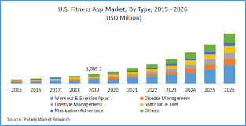
Fitness App Market Combined

